Slide 1

1302 Project Presentation
By: AbdulMujeeb Ahmed, Krishna Amuluru, Jermaine Louis

Slide 2
Our Data Set
The COVID-19 pandemic has had a significant impact on many parts of the world, including Los Angeles County, California. To gain a better understanding of the virus's impact in the area, this report presents an analysis of a dataset containing information about the number of confirmed cases, deaths, and hospitalizations due to the virus. The data was collected daily from various sources and is presented in a CSV file. The code reads and processes the data, including converting the date column to datetime format, sorting the data by date, and dropping unnecessary columns.

Slide 3

Data Set Code

Slide 4

Mean, Median, Variance, Std. Dev.

Slide 5
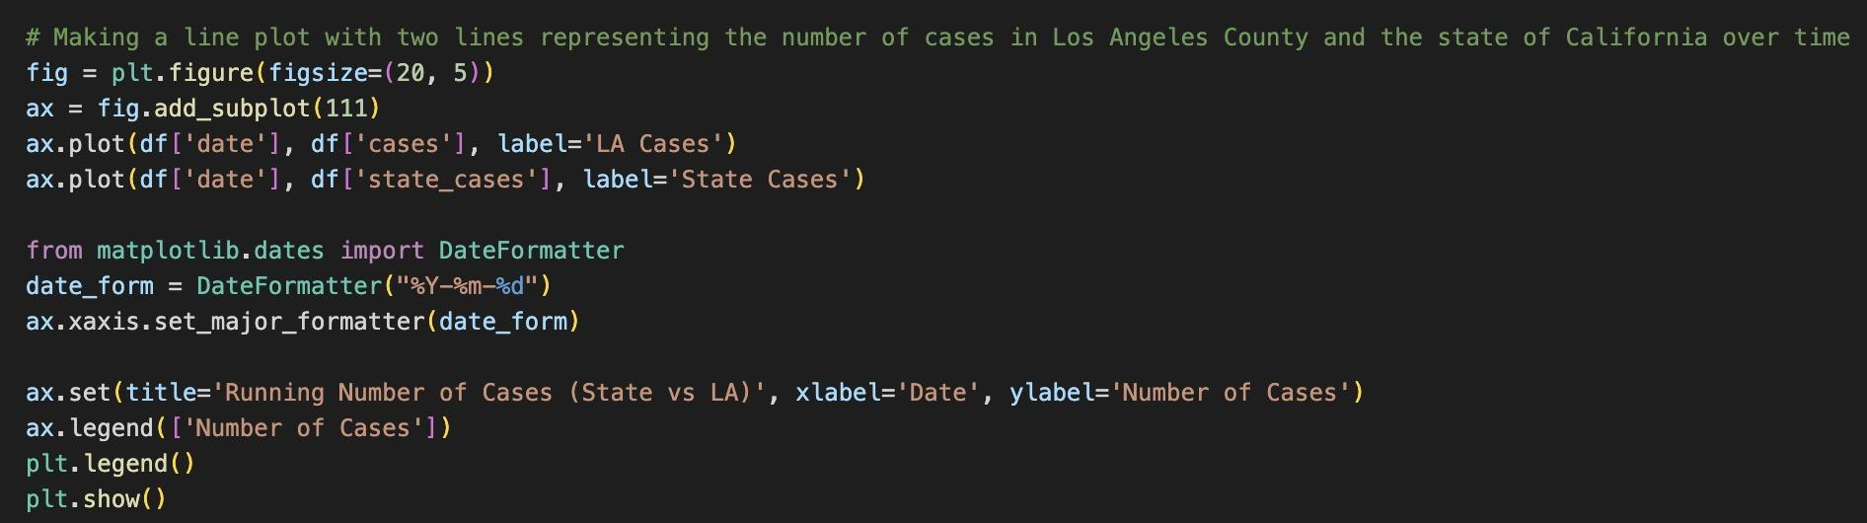
Line Chart Code

Slide 6
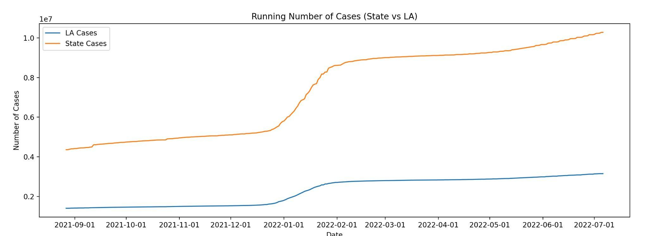
Line Chart
The line plot depicts the running number of cases in Los Angeles County and California over time, showing the pandemic's overall trend in the area. The plot highlights the difference in the number of cases between Los Angeles County and the state of California.

Slide 7
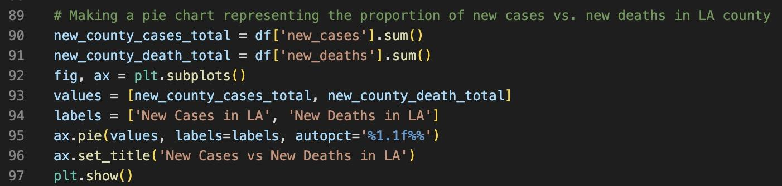
Pie Chart Code

Slide 8
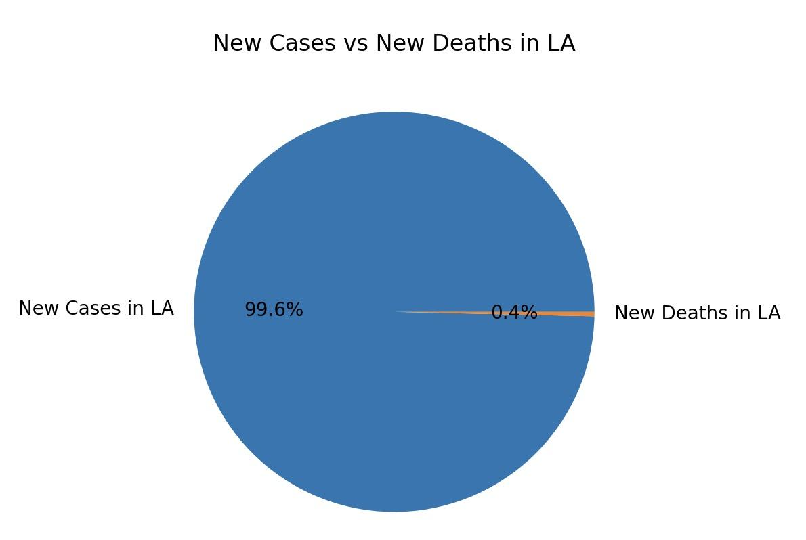
Pie Graph
The pie chart we plotted compared the number of new cases and deaths in Los Angeles County. It showed that the number of new cases was significantly higher than the number of new deaths. This chart is useful in understanding the severity of the pandemic, with new cases comprising a larger proportion of the total than new deaths.

Slide 9

Bar Graph Code

Slide 10
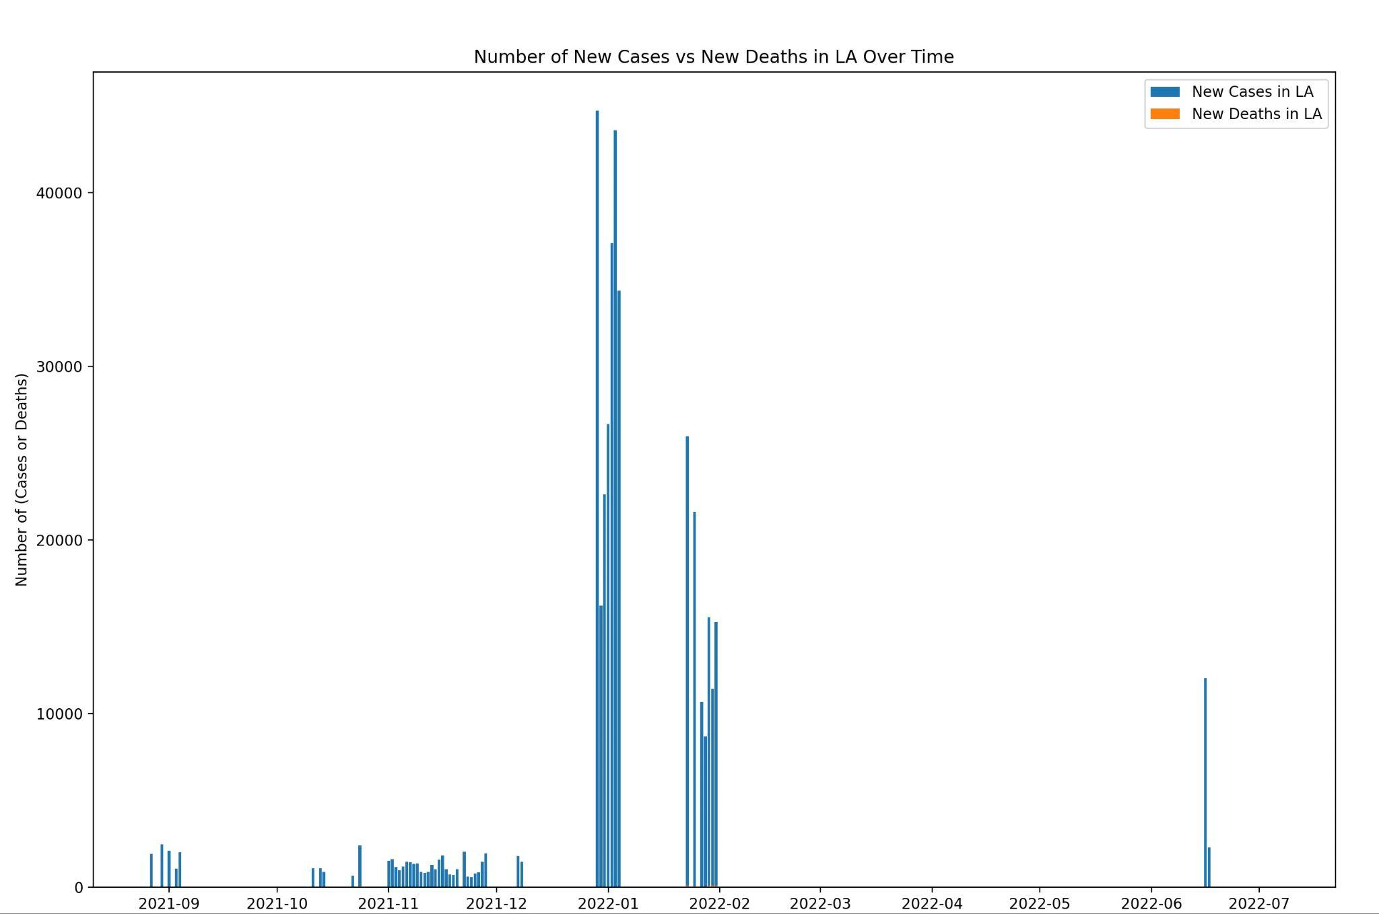
Bar Graph
The bar plot compared the number of new cases vs. new deaths in LA over time. This plot allows us to see trends in new cases and deaths over time and identify any emerging patterns. The plot shows that while the number of new cases has decreased, the number of new deaths has remained relatively stable.

Slide 11
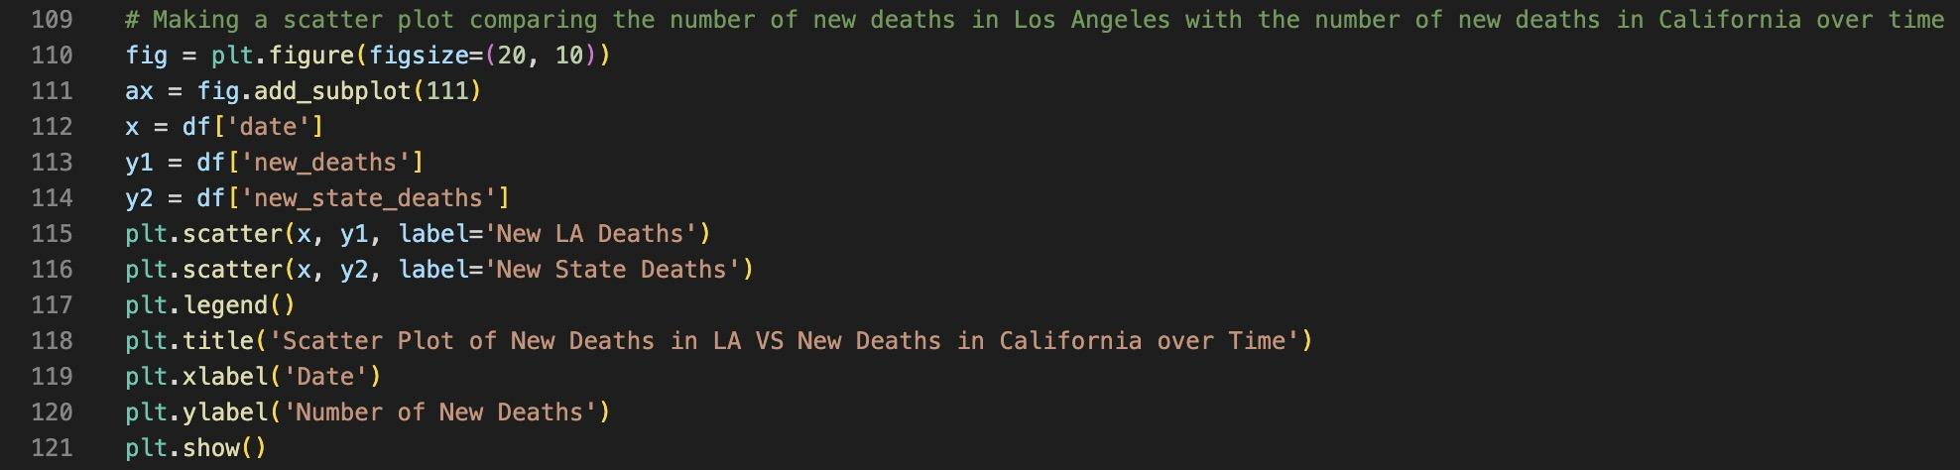
Scatter Plot Code

Slide 12
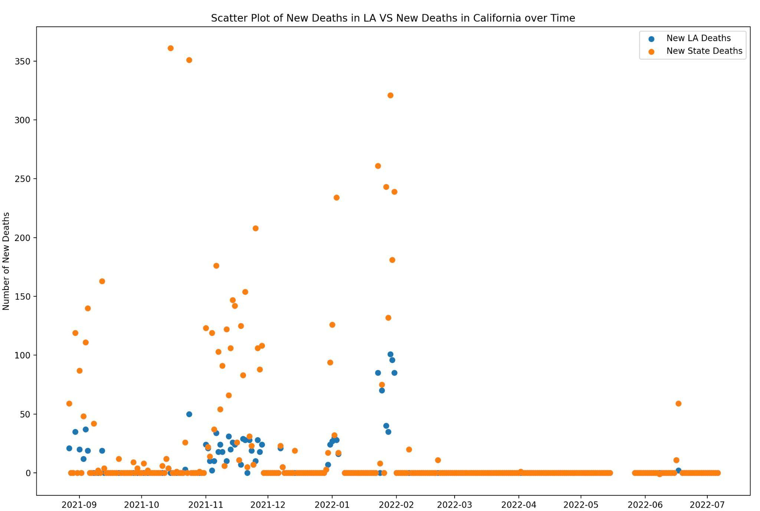
Scatter Plot
The scatter plot is included, comparing the number of new deaths in Los Angeles with the number of new deaths in California over time. This plot allows us to see if there is any correlation between the two variables and whether there is a difference in the pandemic's trend between Los Angeles and California as a whole. The plot shows that the number of new deaths in Los Angeles is generally lower than the number of new deaths in California, and there is a slight correlation between the two variables.

Slide 13
THE END

